Slide 1
Working from the Home Environment & Well-Being Study Data
Sponsor:
Team: Vani Singhal (Team Lead)
Ming-Han Hsieh
Wei-Tse Kao
Jessica Woo

Slide 2
Project Motivation
What is the importance of the project?
Now that many companies are returning back to in-person work style, this project allows us to evaluate one’s health when working from home and if it’s a viable option in the future.

Slide 3
Project Motivation
What is the goal of the project?
To determine how working from home affects one’s mental and physical health over a period of 6 months.
What is the background needed to understand the project?
The ecological momentary assessment approach was used in this project to study how wellbeing is affected by working from home. There were a total of 70 participants for this project, and each participant was given a Garmin watch that collected data 3 times a day. Participants answered the E-Work Life Scale and Flourishing Scale surveys every week on Fridays; they answered the Computer Workstation Checklist every month on Wednesdays.

Slide 4
Work Progress
Data we used:
3 month data and 6 month data
Garmin data
Survey answers (E-Work Life Scale, Flourishing Scale, Daily Breaks, Comfort Visual Analog Scale, Location, Computer Workstation Checklist)
Demographic data
Work completed:
Answered all of the hypotheses
Answered question iv, which was about analyzing stress levels

Slide 5
Type of Data
What type of data will we collect or be analyzing?
Data collected from a Garmin watch that provided information about the wearer’s current location, musculoskeletal discomfort, and number of breaks.
Photos of the study participants were taken to see their workspace ergonomics.
Weekly surveys E-work and Flourishing scale

Slide 6
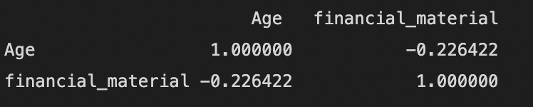
Hypothesis a.
Participants’ age will negatively correlate with financial and material stability (the last two questions on the Flourishing Scale)
Pre-processing steps:
Merged Friday AM and Demographic data on the column “mbl_cod”
Grouped the data by the number of Age and calculated the mean score for financial_material(sum of LIVING_EXPENSE and FOOD_HOUSING)
Dropped rows that had empty or 0 values
3 month data (Correlation used here is pearson correlation)
It can be seen that there is negative correlation between participants age and financial and material stability
With correlation value = -0.22

Slide 7
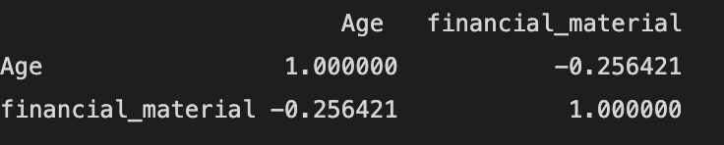
Hypothesis a. cont.
6 month data
It can be seen that there is negative correlation between participants age and financial and material stability
With correlation value = -0.25
Conclusion
This hypothesis is correct for 3 months as well
as 6 months data

Slide 8
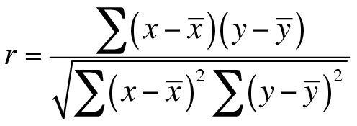
Hypothesis b.
Participants who take an average of 4 breaks per day will positively correlate with productivity scores in the E-Work Life Scale (questions 16-20) and report lower discomfort at one month compared to six-month data.
Pearson correlation coefficient:

Slide 9
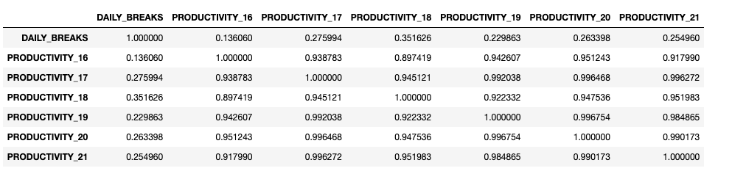
Hypothesis b. cont.
Participants who take an average of 4 breaks per day will positively correlate with productivity scores in the E-Work Life Scale (questions 16-20) and report lower discomfort at one month compared to six-month data.
This is based on the Friday PM and Friday End data.
Pre-processing steps:
Merged Friday PM and Friday End data on the column “mbl_cod”
Grouped the data by the number of daily breaks and calculated the mean score for each Productivity question (16-21 in the E-Work Life Scale)
Dropped rows that had empty or 0 values
Conclusion:
There is a positive correlation between taking an average of 4 daily breaks and productivity scores.

Slide 10
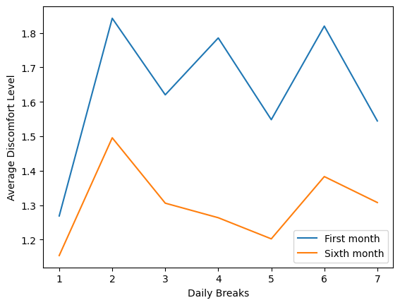
Hypothesis b cont.
Participants who take an average of 4 breaks per day will positively correlate with productivity scores in the E-Work Life Scale (questions 16-20) and report lower discomfort at one month compared to six-month data.
This is based on the Friday AM and Friday End data.
Pre-processing steps:
Extracted the 1 month data and 6 month data from the two datasets
For both the 1 month and 6 month data, grouped it by the number of daily breaks and then found the mean discomfort level
Dropped rows with empty (nan) or 0 values
Hypothesis - Participants who take an average of 4 breaks per day will positively correlate with productivity scores in the E-Work Life Scale (questions 16-20) and report lower discomfort at one month compared to six-month data.
Conclusion:
Participants who take 4 daily breaks report a lower discomfort at six months compared to one month.

Slide 11
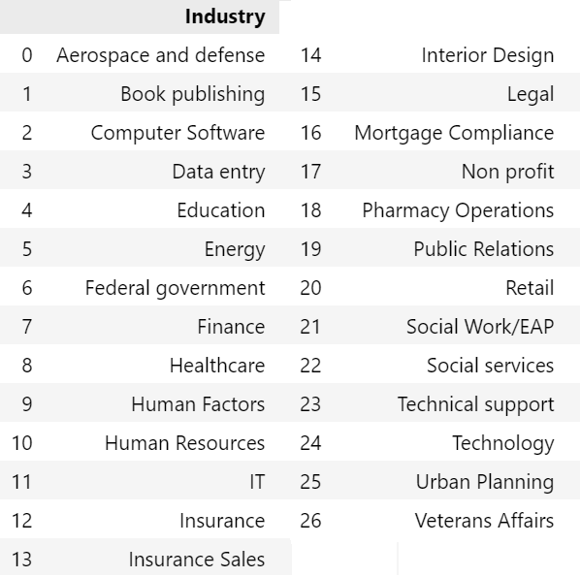
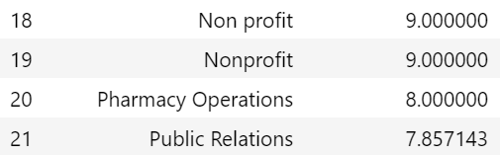
Hypothesis c.
Statement: Participants working in healthcare will have lower mental health scores on the Flourishing Scale than those working in other industries.
Preprocessing: The industry part is typed by participant. Therefore, I check all the typos and industries that can combine together
We get 26 unique industries in total

Slide 12
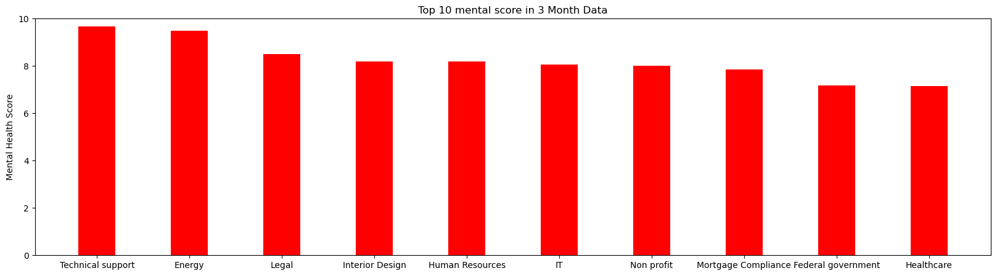
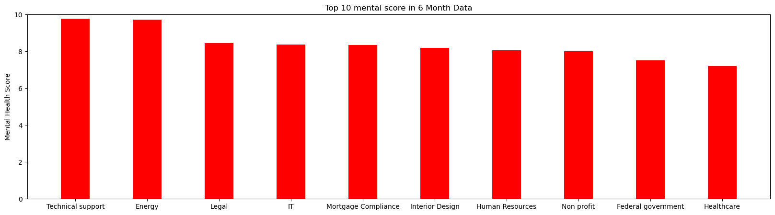

Slide 13
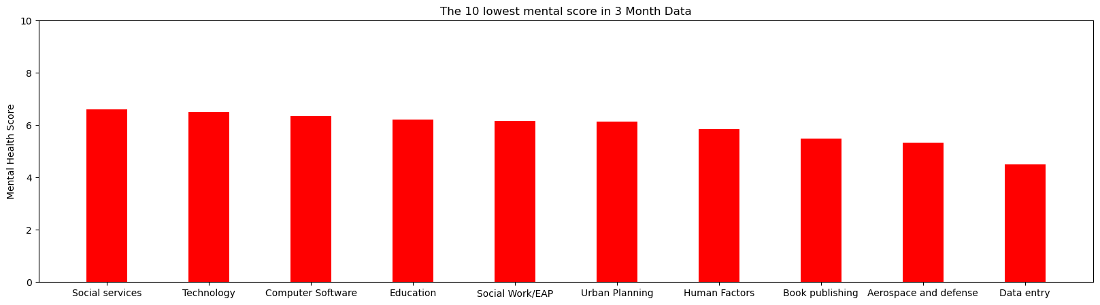
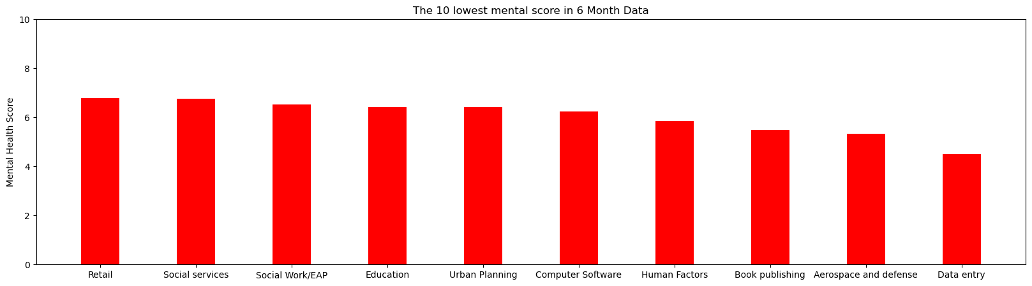

Slide 14
Hypothesis c. - Conclusions
Statement: Participants working in healthcare will have lower mental health scores on the Flourishing Scale than those working in other industries
The hypothesis is not valid since the Healthcare has the 10th highest mental score in 26 unique industries
The lowest mental score industries would be Book Publishing, Aerospace and Defence, Data Entry.

Slide 15
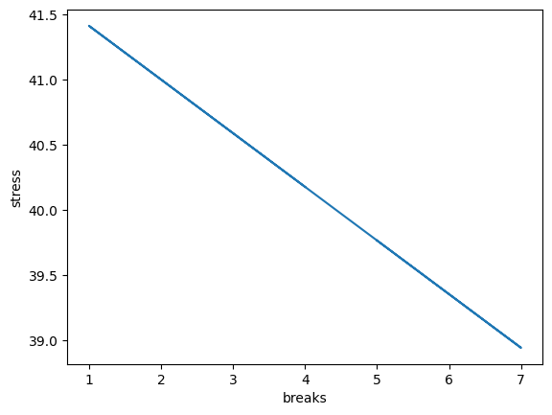
Hypothesis d.
Statement: Participants' stress algorithm will be inversely correlated to their number of breaks.

Slide 16
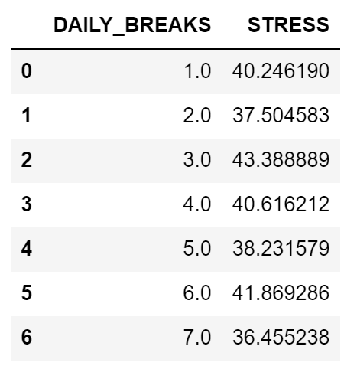
Hypothesis d. - Preprocessing
Drop all the data that stress value is equals to 0
We have tried to normalize the data

Slide 17
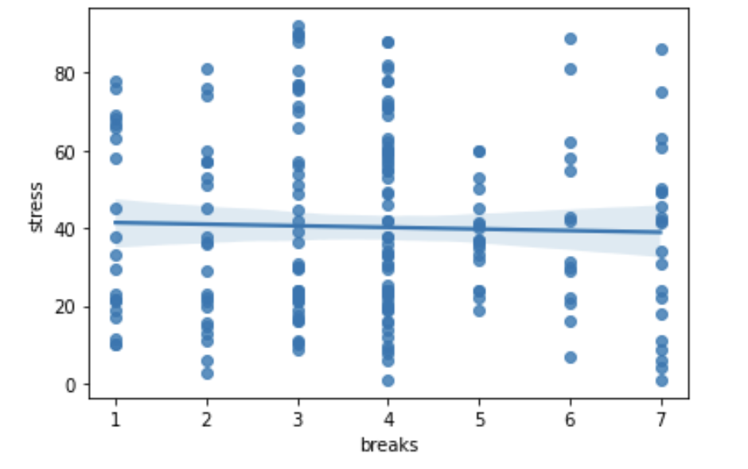
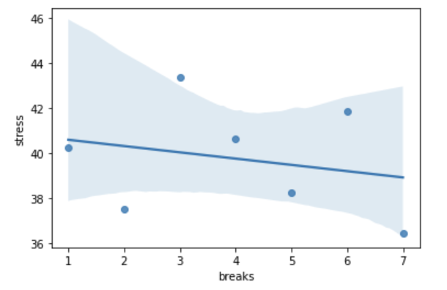
Hypothesis d. - Cont’d

Slide 18
Hypothesis d. - Conclusions
Statement: Participants' stress algorithm will be inversely correlated to their number of breaks
The correlation between participants’ stress levels and the number of breaks is slightly inverse.

Slide 19
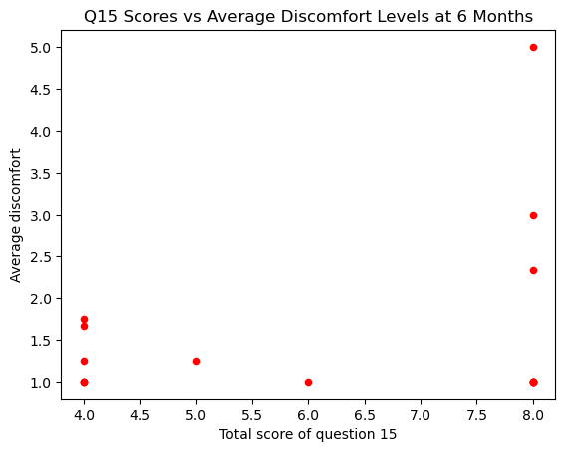
Hypothesis e.
Based on question #15 in the Computer Workstation Checklist (with 4 responses regarding ergonomics training), participants with lower scores will report less pain at 6-months.
This is based on the 6 month data of the Computer Workstation Checklist and the Friday AM data.
Pre-processing steps:
Calculated the total score for question 15 in the Computer Workstation Checklist for each person
Calculated the mean of the total scores if there was more than one score for a person
Merged the previous data with the Friday AM data and calculated mean discomfort level for each person
Dropped the rows that had empty values
Conclusion:
Participants with lower scores for question 15 reported a lower discomfort level at 6 months.
Notes:
How is pain defined? For this we defined pain as high discomfort level.

Slide 20
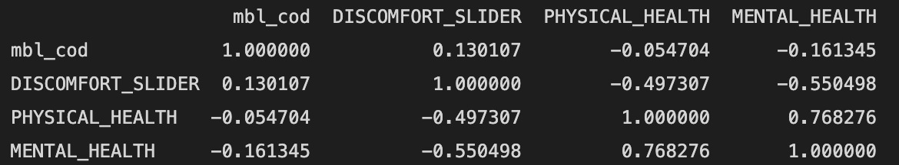
Hypothesis e. Cont.
Based on question #15 in the Computer Workstation Checklist (with 4 responses regarding ergonomics training), participants with lower scores will report less pain at 6-months.
We did analysis between Physical health, mental health vs Discomfort level to see if for hypothesis e we get a different trend as all the 3 factors contribute to pain. (The physical health and mental health score ranges from 0-10 with 0 being POOR and 10 being EXCELLENT. Discomfort level ranges from 1-10 with 1 being low discomfort and 10 being higher discomfort)
We found a correlation between discomfort and Physical health as well as discomfort and mental health using pearson correlation.
Conclusions-
There is negative correlation between discomfort and Physical health as well as discomfort and mental health. Therefore there is no different trend.
By this

Slide 21
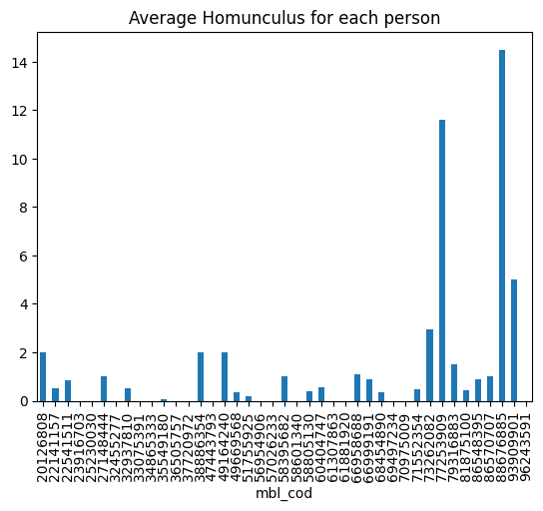
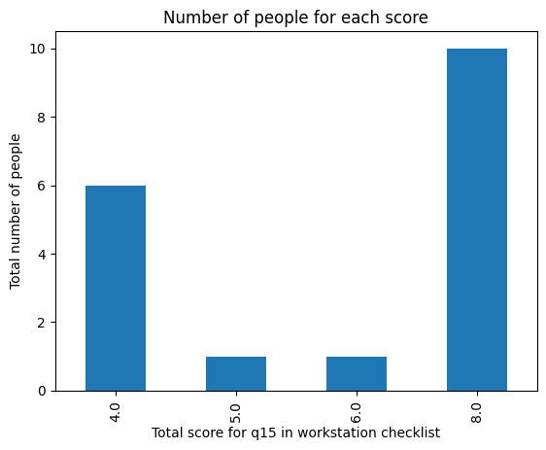
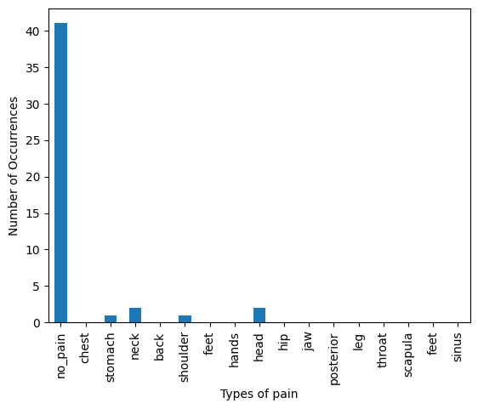
Hypothesis e. cont.
Based on question #15 in the Computer Workstation Checklist (with 4 responses regarding ergonomics training), participants with lower scores will report less pain at 6-months.
Pre-Processing Steps:
Extracted data from the sixth month in Daily PM
Categorized the “OTHER_DISCOMFORT” column in Daily PM into locations the participants experienced pain
Took the sum in “HOMUNCULUS” (since there were only 0 or 1), and got the average score for each participant
Merged the previous data with the columns for question 15 in the Computer Workstation Checklist and added a new column “total_score” to represent the total score for question 15
Dropped rows with empty values

Slide 22
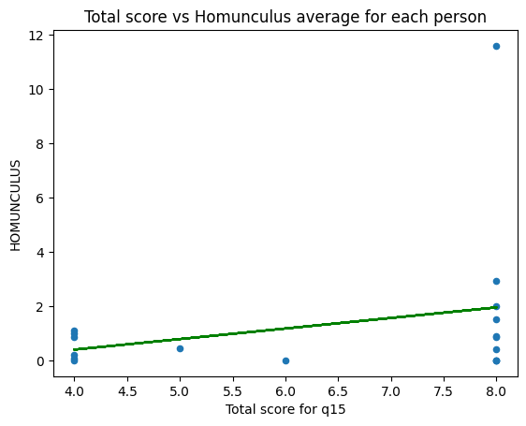
Hypothesis e. cont.
Based on question #15 in the Computer Workstation Checklist (with 4 responses regarding ergonomics training), participants with lower scores will report less pain at 6-months.
Conclusion:
Participants who scored lower in question 15 (i.e. they answered more “Yes”) will report a lower Homunculus score (i.e. they reported with more 0 for the areas of pain)

Slide 23

Analyze and Answer iv.
Statement: Where are people with their stress levels? Using the data from the Garmin watches as well as the survey data, are stress levels Increased, decreased, no change?
STRESS
LEVEL
LOCATION

Slide 24
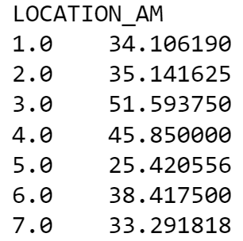
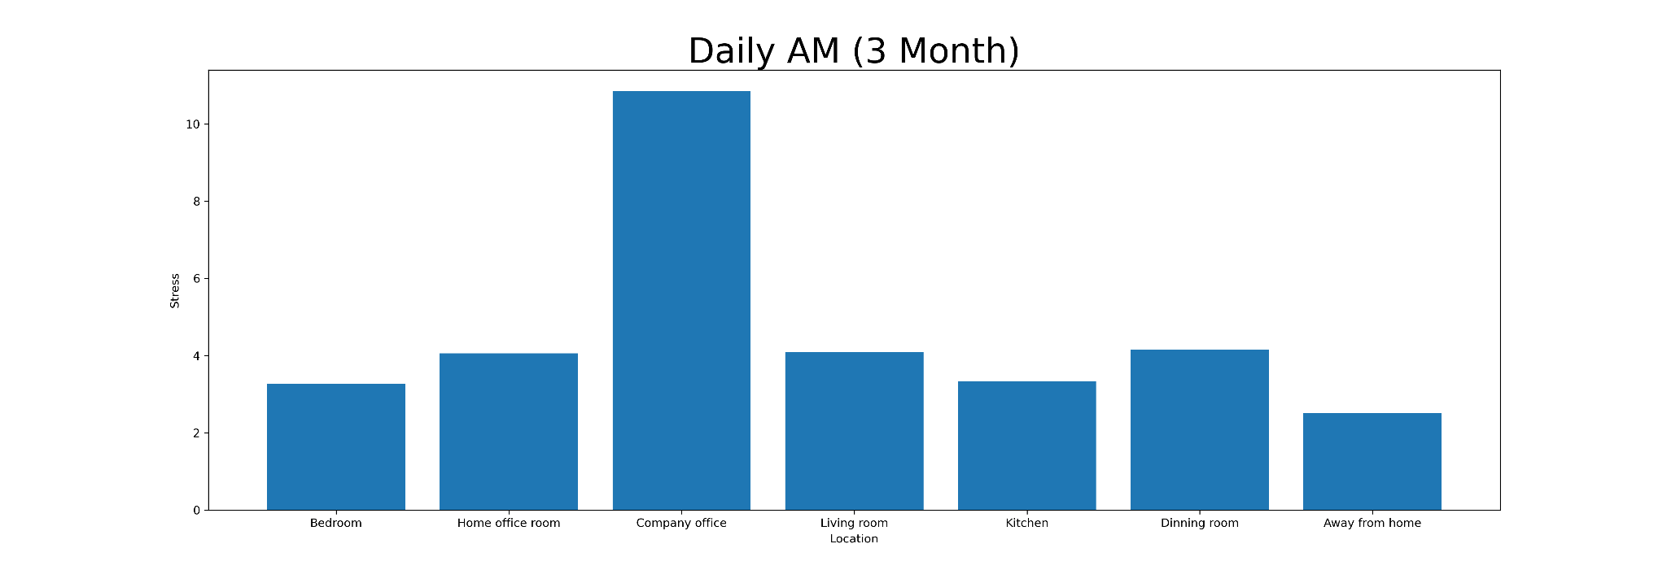
Analyze and Answer iv. - Preprocessing
Remove the rows which stress is 0
Groupby the dataset with locations and calculate the mean of stress level
Change “location ID” to the corresponding locations

Slide 25
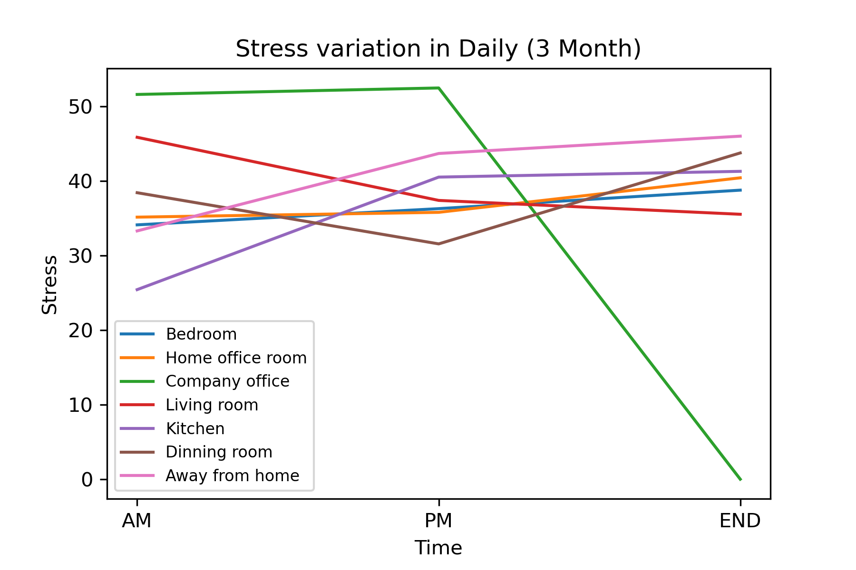
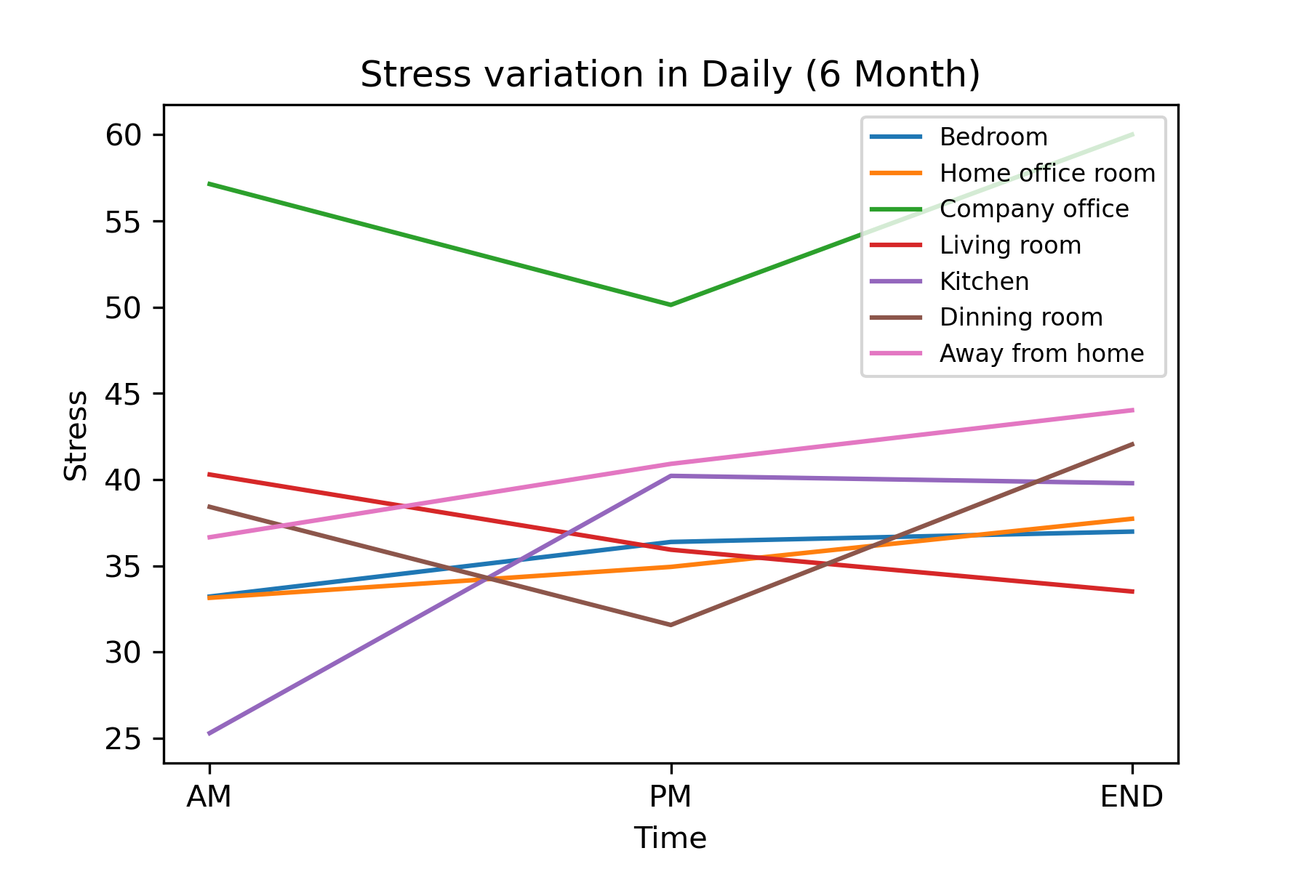
Analyze and Answer iv. - Stress Variation in Daily

Slide 26
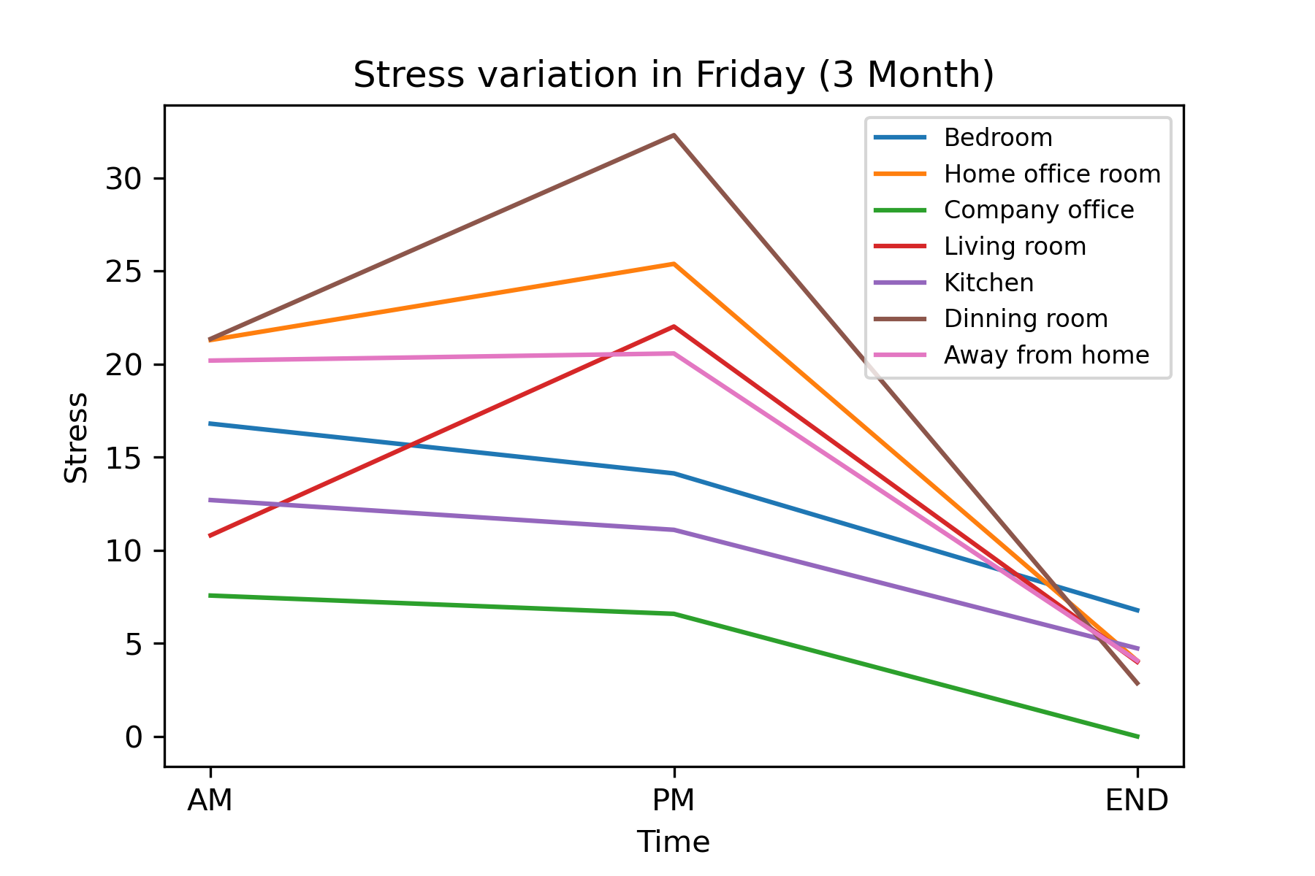
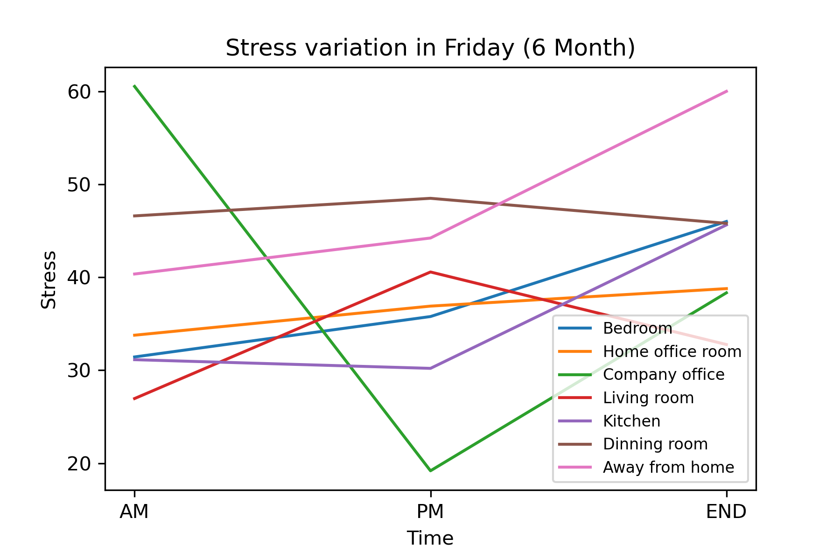
Analyze and Answer iv. - Stress Variation on Friday

Slide 27
Analyze and Answer iv. - Conclusions
Statement: Where are people with their stress levels? Using the data from the Garmin watches as well as the survey data, are stress levels Increased, decreased, no change?
The relationship between stress level and locations has been demonstrated at previous slides.
The pressure level of all locations in daily time only change slightly from “3 Month data” to “6 Month data”.
The pressure level of all locations on Friday increase apparently from “3 Month data” to “6 Month data”.

Slide 28
Limitations & Challenges
What challenges did you encounter working with data?
In our initial attempts at analyzing the Garmin data, we ran into technical issues because of how large all of the Garmin files are. Also, because the number of participants decreases from the third month to the sixth month, the results of our analysis on stress levels seemed “uneven”.
What assumptions have you had to make?
So far, we’ve made the assumption that if there is a 0 in the data, we should drop that row.

Slide 29
Next Steps
We will pre-process each Garmin file by determining which rows can be removed. By pruning each Garmin file, we hope to make them into more manageable file sizes so that we can begin our analysis.
Determine which data we need to do feature engineering on and redo the analysis we’ve done so far to see if it gives us a better analysis
Answer the remaining questions in the Analyze and Answer section

